Slide 1

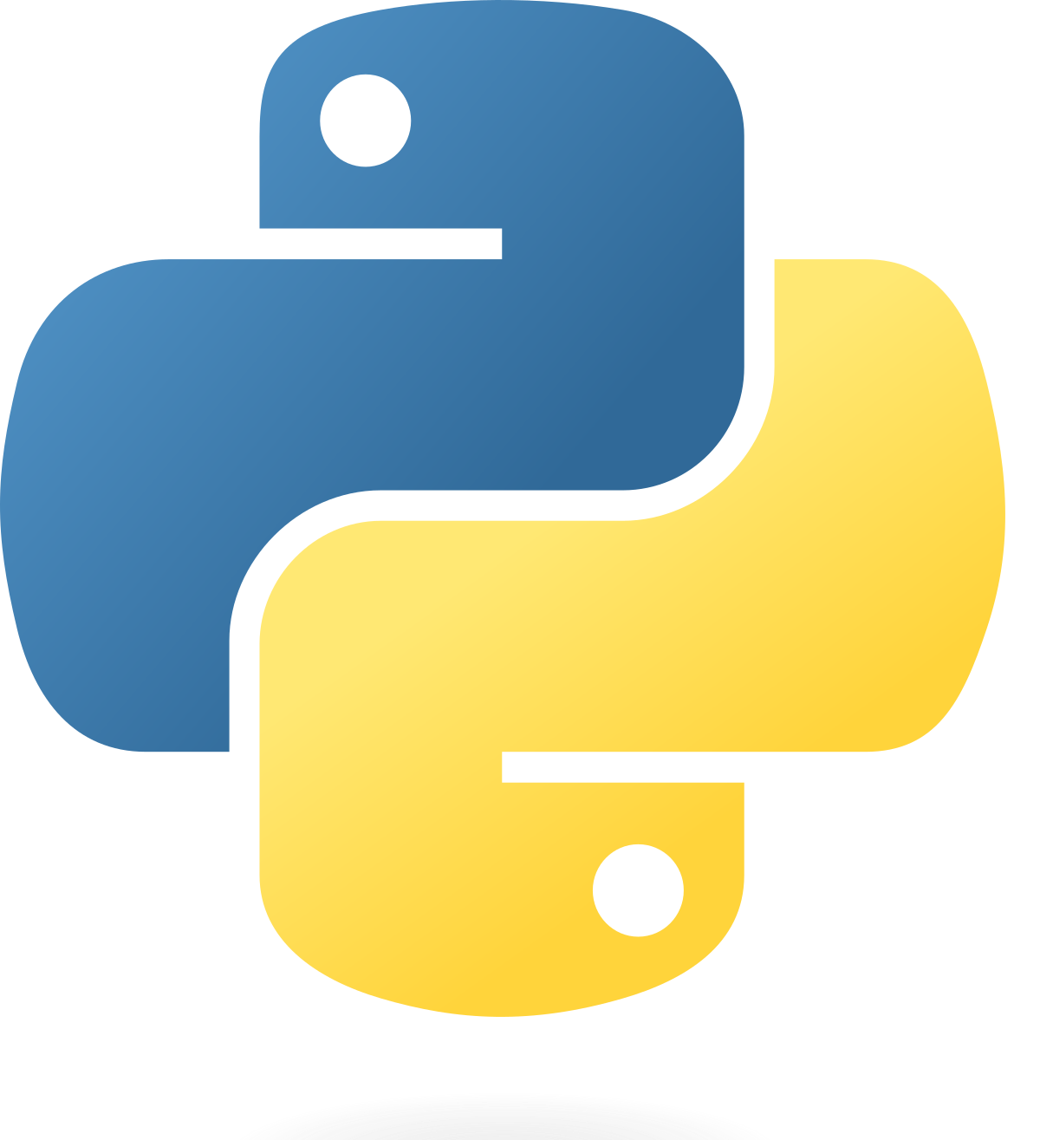
Functions & Modules AND Data Manipulation in Python
VAULT OF CODES
Presented By DEEPAK H

Slide 2
Agenda
VAULT OF CODES
Introduction
Functions in Python
Module in Python
Common Python Modules
Data Types and Data Structures in Python
Data Analysis Libraries in python
Data Manipulation With Python
Data Manipulation Techniques
Data Manipulation Best Practices
Data Manipulation Examples
Conclusion

Slide 3
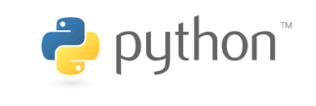
Introduction
VAULT OF CODES
FUNCTION & MODULES: Functions and modules are fundamental concepts in Python Programming.
Functions allow us to group code into reusable blocks, which can be called multiple times with different inputs.
Modules are files that contain Python code provide additional Functionality to our programs.
DATA MANIPULATION IN PYTHON: Data Manipulation refers to the Process of changing or transforming data to make it more useful for analysis or further processing. Python provides various tools and techniques for manipulating data efficiently , making ita popular choice for data analysis and data science

Slide 4
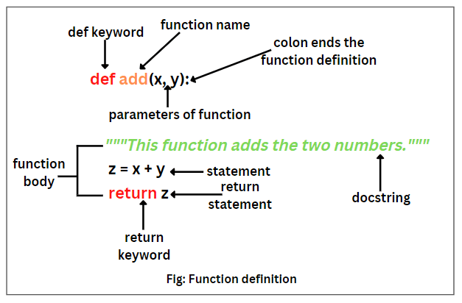
FUCTIONS IN PYTHON
Definition of Functions: In python, A function is a named block of code that performs a specific task, It takes inputs, is called arguments, and may return a result. Function can be defined using the ‘def’ Keyword.
Syntax of functions: The syntax for defining a function in python is:
“python def function_name(parameters):#Code block”
Return Statement: The ‘return’ statement is used to specify the value to be returned by a function.it is optional and can be used to return a single value or multiple values as a tuple.
Parameters: Parameters are placeholders for values that a function needs to perform its task. They can be mandatory or optional, and can have default values.
Local and Global Variables: Local variables are defined Global variables are defined outside of any function and can be accessed within the function. Global variables are defined outside of any function and can be accessed by any function or code block.
Function Composition: Function composition is the process of combining multiple functions to create
Example for functions in Python

Slide 5
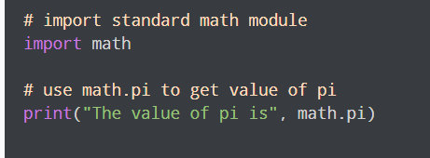
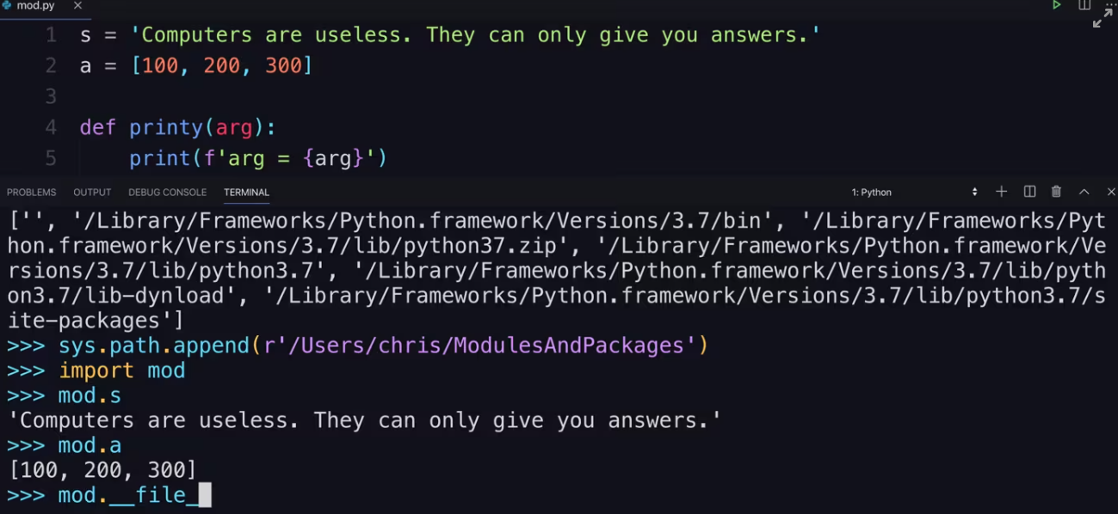
Module in Python
VAULT OF CODES
Definition of Module: A module is a file containing Python definitions and statements. It can define functions, classes, and variables that can be used in other Python programs.
Creating and Using Modules: To create a module, we simply define our functions, classes, or variables in a .py file. Once defined, we can import and use the module in our Python programs.
Importing Modules: To use a module in Python, we need to import it using the ‘import’ keyword. This allows us to access the functions, classes, and variables defined in the module.
Module Search Path: When importing a module, Python searches for the module file in a predefined order. This search path can be modified using the ‘sys’ module.

Slide 6
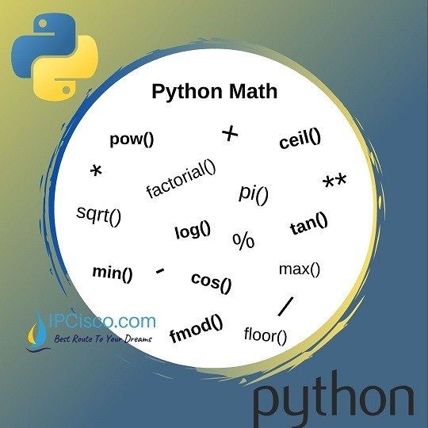
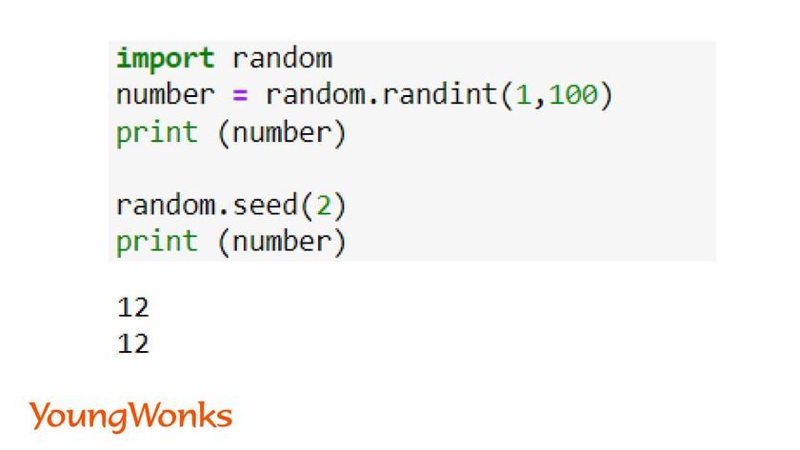
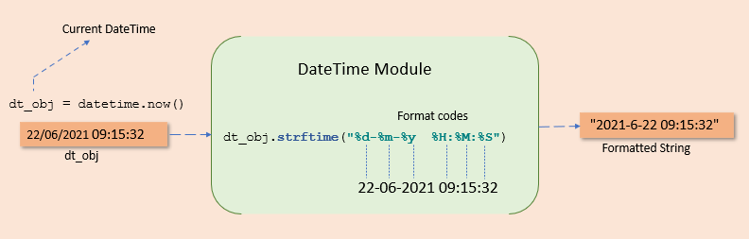
COMMON PYTHON MODULES
VAULT OF CODES
Math Module: The math module provides various mathematical functions and constants, such as trigonometric functions, logarithmic functions, and mathematical constants like ‘pi’.
Random Module: The random module provides functions for generating random numbers, random selections, and random shuffling. It is useful for simulations, games, and cryptography.
Datetime Module: The datetime module provides classes and functions for working with dates and times. It allows us to perform various operations, such as creating date objects, formatting dates, and calculating time differences.

Slide 7
DATA TYPES AND DATA STRUCTURES IN PYTHON
VAULT OF CODES
Different Data Types in Python: Python provides various built-in data types, including numeric types (int, float), Boolean type (bool), string type (str), sequence types (list, tuple), mapping type (dict), and set type (set). Each data type has its own characteristics and operations.
String Manipulation: Strings are sequences of characters and can be manipulated using various built-in string methods and operators. Common operations include concatenation, slicing, and formatting.
List: A list is an ordered and mutable collection of objects. It allows duplicate elements and can be modified using various list methods. Lists are enclosed in square brackets [] and can contain elements of different data types.
Tuple: A tuple is an ordered and immutable collection of objects. It is similar to a list, but its elements cannot be modified once defined. Tuples are enclosed in parentheses () and can contain elements of different data types.
Dictionary: A dictionary is an unordered collection of key-value pairs. Each key is unique and is used to access its associated value. Dictionaries are enclosed in curly braces {} and can contain elements of different data types.

Slide 8
Data Analysis libraries in python
VAULT OF CODES
Pandas: Pandas is a powerful library for data manipulation and analysis.it provides data structures like data frames and series, which allow for easy manipulation and analysis of structured data. Pandas has extensive functionality for data cleaning ,transformation,aggregation,and visualization.
NumPy: NumPy is a fundamental library for scientific computing in python.it provides support for large, multi-dimensional arrays and matrices, along with a collection of mathematical functions and tools. Numpy is widely used for numerical computations and data manipulation tasks.
Matplotlib: Matplotlib is a plotting library for creating visualizations in python.it provides a MATLAB-like interface and is highly customizable. Matplotlib offers a wide range of plot types and styles. Making it suitable for creating various types of charts, graphs and visualizations.
Seaborn: seaborn is a data visualization library that is built on top of matplotlib .it provides a higher-level interface for creating attractive and informative statistical graphics. seaborn simplifies the creation of complex visualization tasks and offers addition functionality for statistical analysis.

Slide 9
DATA MANIPULATION WITH PYTHON
VAULT OF CODES
Reading and Writing Data from/to Files: Python provides various libraries for reading and writing data from/to different file formats, such as CSV, JSON, AND XML. These libraries allow us to manipulate data stored in files and perform operations like reading, writing updating, and deleting data.
CSV (Comma-Separated Values): CSV is a common file format used for storing tabular data. Python provides the ‘csv’ module, which allows us to read and write CSV files easily. We can perform operations like reading data into a list or dictionary, writing data from a list or dictionary to a CSV file, and manipulating CSV data using various methods provided by the module.
JSON (JavaScript Object Notation): JSON is a lightweight data interchange format that is easy for humans to read and write and easy for machines to parse and generate. Python provides the ‘json’ module, which allows us to work with JSON data. We can read JSON data from a file, convert into Python data structures, manipulate the data, and write it back to a file.
XML (eXtensible Markup Language): XML is a markup language that defines rules for encoding documents in a format that is both human-readable and machine-readable. Python provides the ‘xml’ module for working with XML data. We can parsed XML data, navigate through the XML tree structure.

Slide 10
Data Manipulation techniques
VAULT OF CODES
Filtering: filtering involves selecting specific rows or columns from a dataset based on certain conditions. This is useful for narrowing down the data to a specific subset that meets the desired criteria.
Sorting: Sorting arranges the rows or columns of a dataset in a specific order, such as ascending or descending. This allows for easier analysis and visualization of the data.
Grouping: Grouping involves grouping rows based on the values of one or more columns .This is useful for aggregating and summarizing data based on the common attribute.
Joining: joining combines two or more datasets based on a common key or column, This allows for the merging of data from multiple sources for further analysis or visualization.
Transforming: Transforming involves applying functions or operations to the data to create new variables or modify existing ones,this allows for the creation of derived features or the cleaning of data.
Pivoting: pivoting transforms data from a long format to a wide format, where each unique value of a certain column becomes a separate column in the resulting dataset. This is useful for creating summary tables or for reshaping the data for specific analysis or visualizations

Slide 11
DATA MANIPULATION BEST PRACTICES
VAULT OF CODES
Efficient coding practices: Using efficient coding practices such as vectorization, avoiding unnecessary iterations, and optimizing code execution can significantly improve data manipulation performance.
Error handling: Proper error handling is important to ensure code robustness and prevent unexpected errors or crashes. This includes handling invalid inputs, error messages, and exception handling.
Memory management: Efficient memory management involves optimizing memory usage to minimize the memory footprint of data manipulation operations. This includes releasing memory when it is no longer needed and avoiding memory leaks.
Performance optimization: Performance optimization techniques, such as using appropriate data structures, parallel processing, and caching, can help improve the speed and efficiency of data manipulation operations.

Slide 12
Data Manipulation Examples
VAULT OF CODES
Data cleaning and Preprocessing: Real-world data often contains errors, missing values or inconsistencies. Python provides powerful tools and libraries for cleaning and preprocessing data to ensure its quality and suitability for analysis.
Data aggregation and summarization: Aggregating and summarizing data is common in data analysis tasks. Python offers flexible and efficient methods for grouping, aggregating and summarizing data, allowing us to derive meaningful insights from large datasets.
Data Visualizations: Python’s data manipulation libraries, along with visualization libraries such as matplotlib and seaborn, enable the creation of insightful and visually appealing visualizations. Visualizations help in understanding patterns, trends and relationships in the data.

Slide 13
Conclusion
VAULT OF CODES
Key Takeaways: Functions and Modules are essential concepts in python for code modularity. Reusability and organization. Data manipulation in python involves various techniques, libraries and best practices for efficient and effective data analysis and manipulation
Resources for further learning: There are numerous resources available for further learning about functions, modules and data manipulation in python. Online tutorials, Documentation, Books and courses can help deeper your understanding and mastery of these concepts

Slide 14
Thank YOU…
VAULT OF CODES

